Slide 1
I) Super Drugs Prescriptions

Slide 2
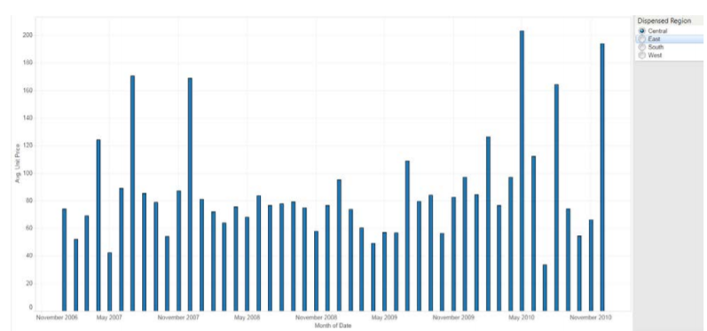
Question 1: Exactly recreate the following visualization of the average prescription price over time

Slide 3
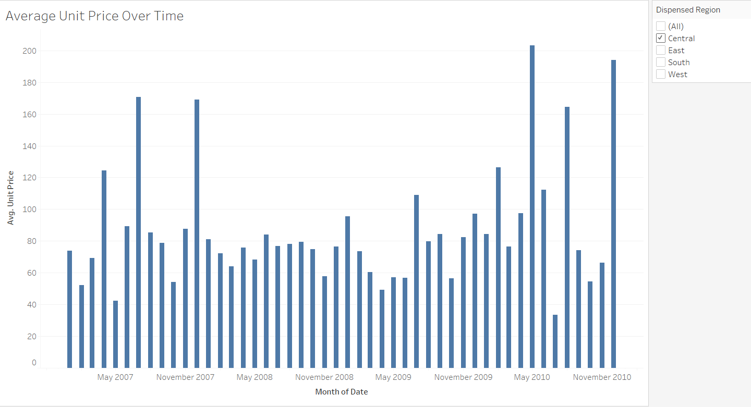
Answer: This is my visualization.

Slide 4
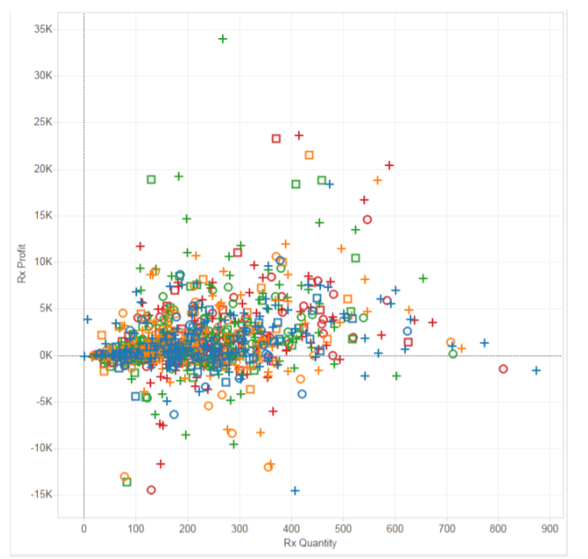
Question 2: Exactly recreate the following of prescription quantity vs. profit. The color of each mark denotes the region, and the shape denotes the drug supplier:

Slide 5
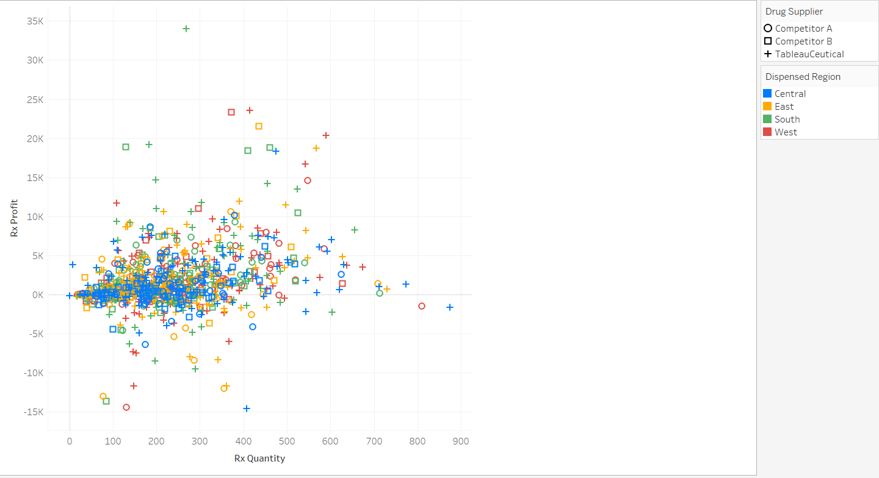
Answer: This is my visualization.

Slide 6
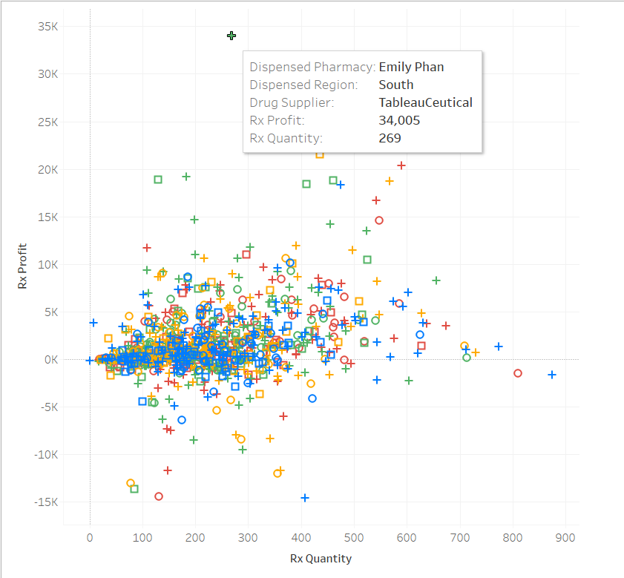
Question 2)a): What pharmacy and drug supplier represented the highest profit mark on the viz, across all regions?
Answer: If we hover our mouse to the point with the highest profit, we could see all the details. In fact, the pharmacy and drug supplier that represented the highest profit on the viz are respectively Emily Phan and TableauCeutical

Slide 7
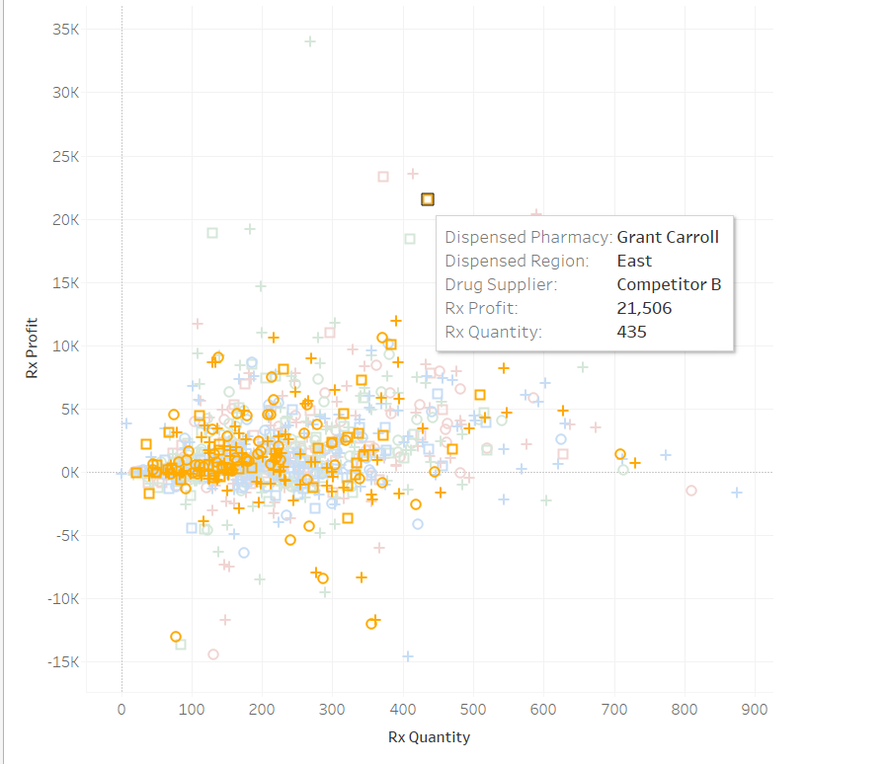
Question 2)b): What pharmacy and drug supplier represented the highest profit mark on the viz, in the East Region?
Answer: In that case, we only wanted a specific region which is the East. We could easily filter in this visualization and choose the region that we want. In that case we chose the East region and we could see that Grant Carroll is the pharmacy with highest profit. Also Competitor B is the Drug supplier with the highest profit mark in that region.

Slide 8
II) Flight Data

Slide 9
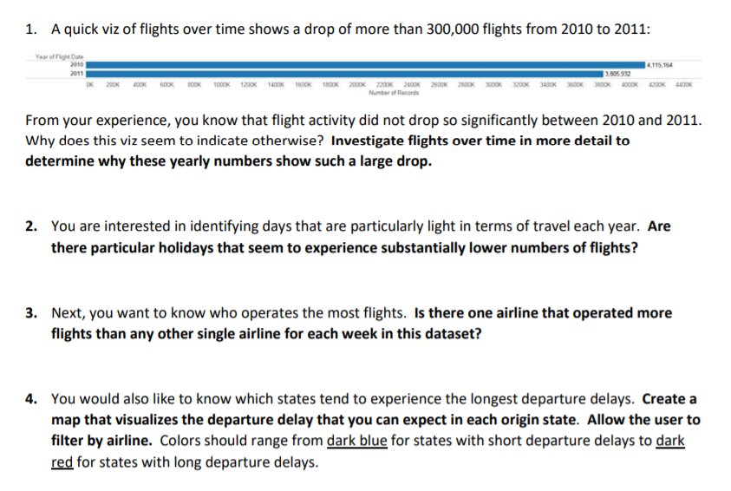

Slide 10
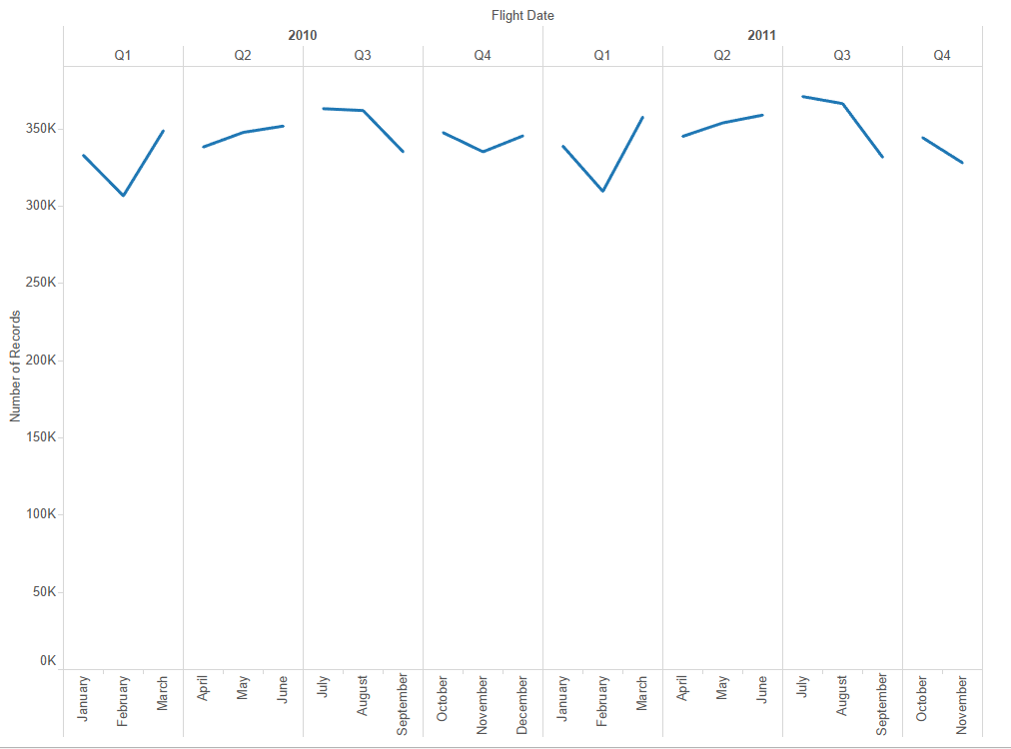
Answer for question 1: This is my visualization for the first part of the question
We could clearly see that Our data is lacking in December 2011, thus the drop in sales that the first visual presented.

Slide 11
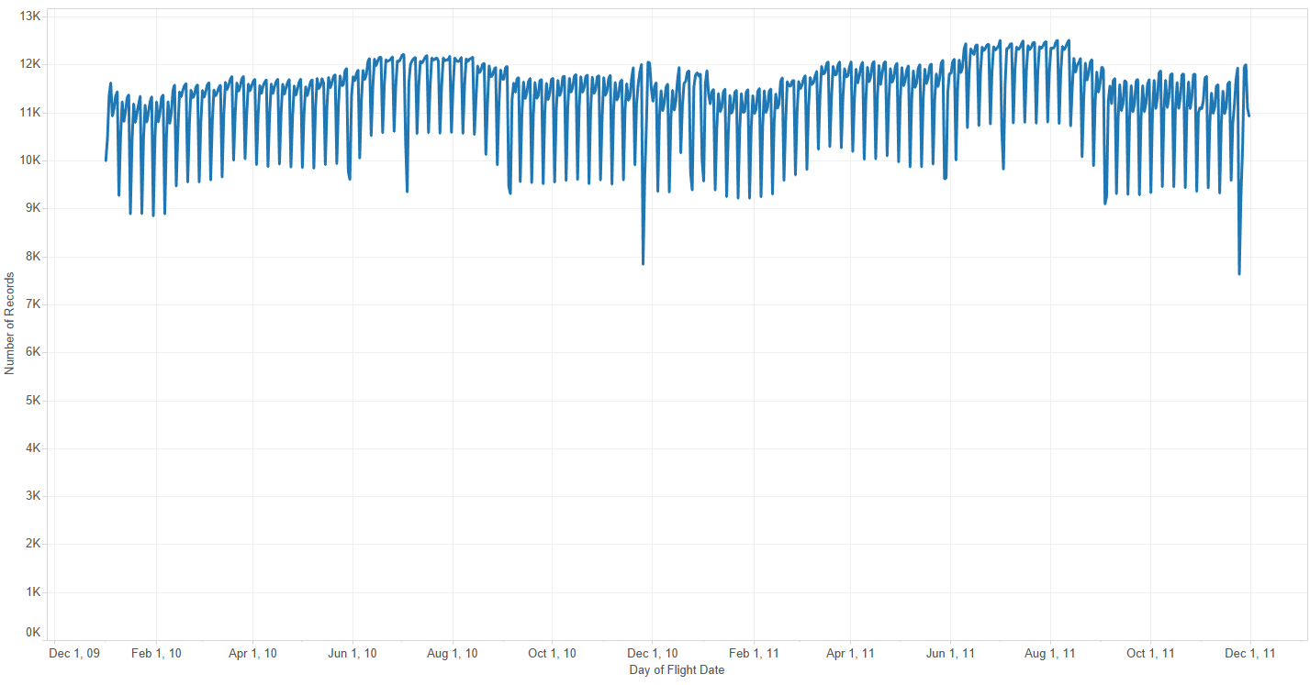
Answer for question 2:
We could see a big downward peak in 2010, November 25th and November 24th in 2011, which in coincide with thanksgiving day.

Slide 12
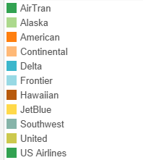
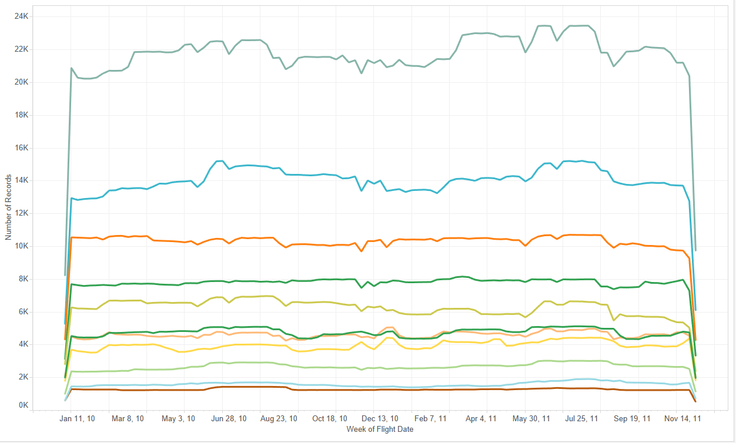
Answer for question 3:
Judging from this graph, we could clearly see that Southwest airline operates the most in every week of the year 2010 and 2011.

Slide 13
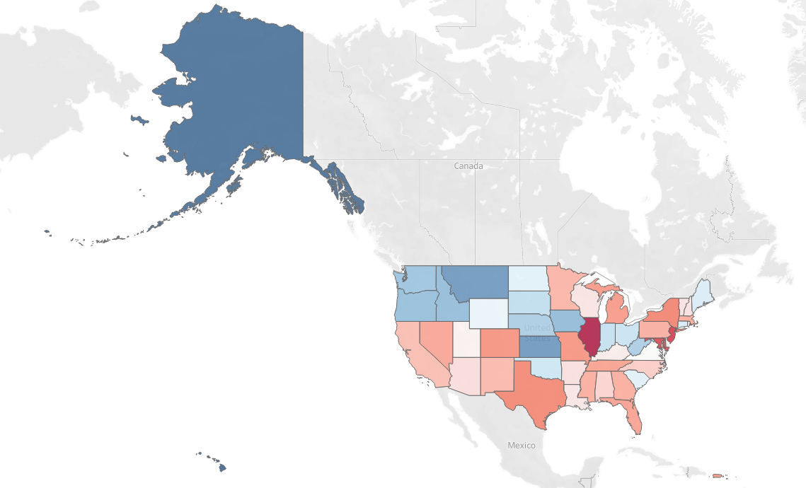
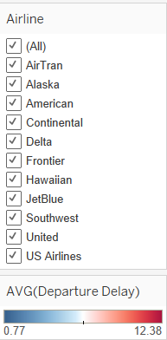
Answer for question 4: Here is the visualization that I have created with the corresponding filters and colors ranging from dark blue (short departure delays) to dark red (long departure delays)

